Slide 1
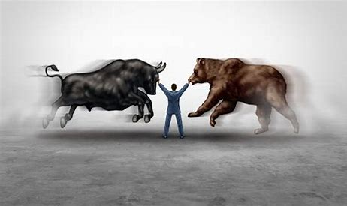

Stock market prediction using machine learning
Piyush Saraf (19BAI10041)

Slide 2

Stock market
The Stock Market is an electronic market place where the buyers and sellers meet and trade their point of view.
From an investment point of view, we always want maximum returns on our investments, with minimum risk. For this, one of the most common ways is to open a Fixed Deposit account in a bank.
The risk is minimum, so are the returns, close to 6% returns per annum.
A different way to invest would be to invest in different asset classes. The 2 most common are Equities (Stocks and Shares) and Commodities (Gold, Silver, Crude Oil)

Slide 3
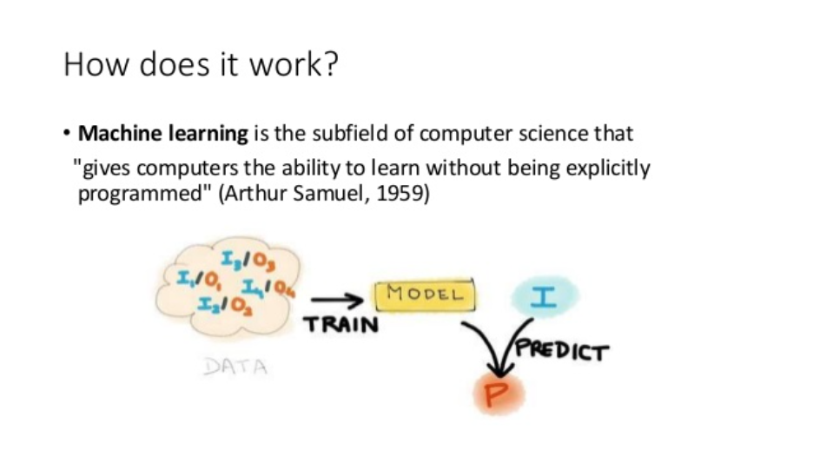
__Machine learning__

Slide 4
WHY MACHINE LEARNING FOR STOCK MARKET
Finance is all about information
Today’s world is information flooded. Everyone has different opinion. Often, it becomes confusing as to whom, we should listen, and whom to ignore.
Machine Learning doesn’t give a biased decision as we humans do. For example, we trust our close relatives and friends for product recommendation than the sales manager in the shop despite the fact that the sales manager has more information about the product.
Machines can keep all the accounts without a mess!
Machine Learning considers all the information into account for giving its prediction which we humans might sometimes miss out.

Slide 5
Datasets used for creating the project
Hero Motors daily share price OHLC (Open, High, Low, Close) – HEROMOTOCO.csv
Commodities datasets – GOLD.csv, CRUDE_OIL.csv
Other different datasets divided into Large_Cap, Mid_Cap and Small_Cap of different other companies based on capital money invested.
Nifty50 dataset

Slide 6
Project pipeline
This project is divided into 6 code files, based on different working requirements and outcomes.
Module 1 includes processing and analyzing data. Processing includes removing unknown values from the data or replacing unknown values with values which make sense, maybe 0. Analyzing the data includes finding out the trend of a stock price.
Module 2 deals with Data Visualization and Technical Analysis. Absolutely no one can go through millions of rows and columns, that’s why we always prefer the data in a plotted form to draw better inferences.

Slide 7
Contd…
The proper workflow of a Machine Learning project involves starting with a base model like linear regression or classification based on the problem and then moving towards more complex models for achieving better accuracy.
Module 3 deals with fundamental analysis using Regression. This would introduce Regression related inferences to be drawn from the data. Regression is basically a statistical approach to find the relationship b/w variables. In machine learning, this is used to predict the outcome of an event based on the relationship b/w variables obtained from the dataset. More often than not, we utilize linear regression to come up with an ideal inference.
Module 4 has trade call prediction using Classification.

Slide 8
Contd…
In Module 5, we look at investment portfolio Optimization with Python, the fundamental concept of diversification and the creation of an efficient frontier that can be used by investors to choose specific mixes of assets based on investment goals, i.e., the trade off b/w their desired level of portfolio return vs their desired level of portfolio risk.
Modern Portfolio Theory suggests that it is possible to construct an “efficient frontier” of optimal portfolios, offering the maximum possible expected return for a given level of risk
Last module 6, we perform clustering for Diversification analysis. Clustering is a ML technique that involves that grouping of data points. In financial markets, clustering is used in grouping objects sharing similar characteristics. Investors will use this approach to build a diversified portfolio. Stock that exhibit high correlations in returns fall into one basket, those slightly less correlated in another, and so on, until each stock is placed into a category.

Slide 9
conclusion
In this project, I have demonstrated the use of Machine Learning for predicting Stock Market Analysis. Basically, in earlier times stock market was predicted manually but as time advanced, it was converted into semi-automatic form.
The use of Machine Learning gives an added advantage in predicting Stock Market and helps us in deciding whether a particular stock is fruitful for investment or not.
One thing to note is that we CANNOT rely 100% on Machine Learning for predicting stock market. We should use our instincts along with the calculated predictions for best results.

Slide 10
references
How Does Investing Work? Investing in Stocks for Beginners (talkdistrict.com)
Machine Learning for Stock Market Investing | by Bingran Lu | Data Driven Investor | Medium
Stock Price Prediction Using Machine Learning | Deep Learning (analyticsvidhya.com)
Choosing a suitable Machine Learning algorithm - GeeksforGeeks

Slide 11


